Slide 1

SMART PHONE DIRECTORY SYSTEM

Slide 2
Hola!
TEAM MATES
DIVYA SRI N -AP21110010067
BHUVITHA T -AP21110010094
KUMAR VARMA T -AP21110010106
VARSHITH J -AP21110010107

Slide 3
ABSTRACT
Through this project we will be implementing a smartphone directory that collects contact data from the user until the user prompts the program to. Contact data refers to the contact’s name, phone number, date-of-birth, a category that contact belongs to (Friends, Family, Work, Other), e-mail address. The user may enter as much data as he can in the mentioned data labels. If some labels remain void of data, store it as None. A name & the number is mandatory to create contact. Implementation of the following operations will be done on the directory:
•Insert
•Delete
• Search
•Display

Slide 4
INTRODUCTION
initial_phone_book()
menu()
add_contact()
remove_existing()
deleteall()
displayall()
Search_existing()
directory.thanks()
This project “SMART PHONE DIRECTORY SYSTEM” have been developed using python. Smart phone directory system (Contact books) is a useful and widely used kind of application. They’re everywhere. You probably have a contact book on your phone and on your computer. With a contact book, you can store and manage contact information for your family members, friends, coworkers, and so on. The main functions available in this project are

Slide 5
Modules
initial_phone_book(): The first function to run, it initializes the phonebook.
•menu(): It displays the choices available to the user and returns the choice entered.
•add_contact(): It adds a new contact to the Contacts directory.

Slide 6
remove_existing(): It removes an existing contact from the Contacts directory.
deleteall(): It deletes all the contacts from the Contacts directory.
displayall(): It displays all the contacts from the Contacts directory.
Search_existing(): It will search and display an existing contact in the Contacts directory.
thanks() :

Slide 7
Roadmap for program
please enter intial no. of contacts
Enter the number
Enter the DOB
OUTPUT
1
3
5
7
2
4
6
Enter the name
Enter mail address
Enter the category

Slide 8
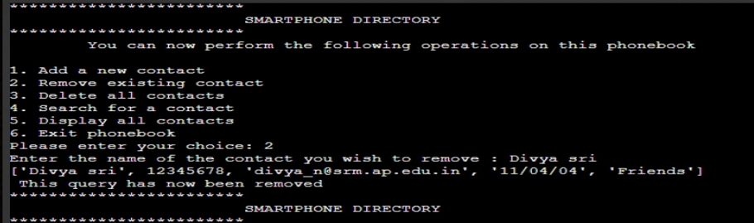
1. OUTPUT

Slide 9
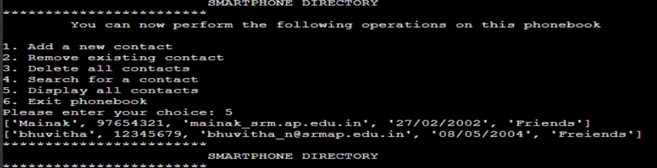
2
OUTPUT

Slide 10
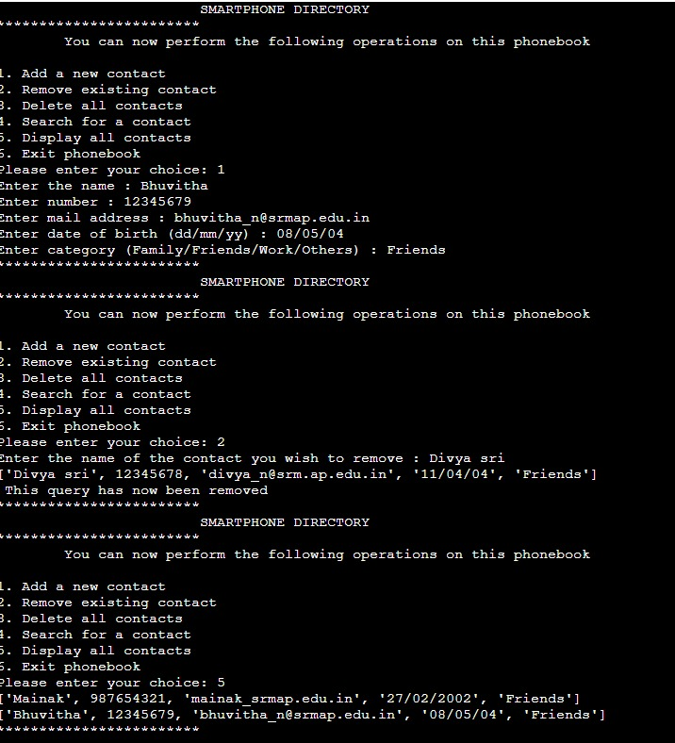
3 OUTPUT

Slide 11
conclusion
We have successfully written a python program for a smart phone directory system The main function we learnt in this project are:
Decision making
Functions
lists

Slide 12
thank you☺

